Slide 1
Karnaugh maps

Slide 2
Index
Karnaugh maps
Logic Minimization
Seven-segment Display Decoder
Don’t Cares

Slide 3
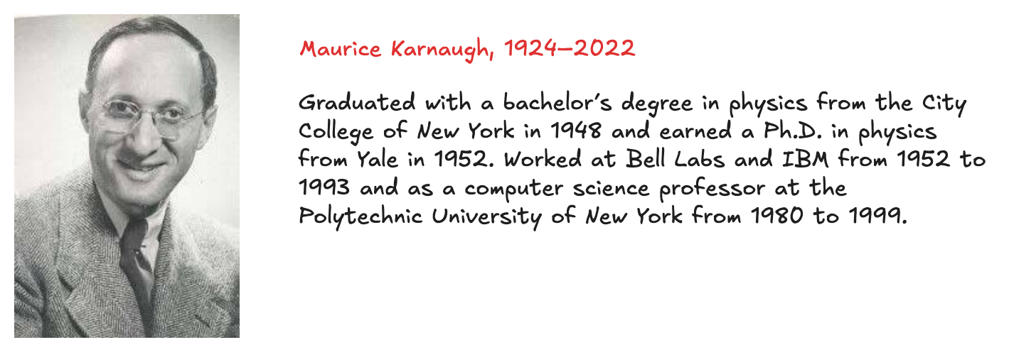
Karnaugh maps
K-maps are a graphical method for simplifying boolean equations
works well for problems with up to four variables
give insight into manipulating boolean equations
invented in 1953 by Maurice Karnaugh, a telecommunications engineer at Bell Labs
Recall that logic minimization involves combining terms
two terms containing an implicant P and the true and complementary forms of some variable A are combined to eliminate A:
PA + PA = P
Karnaugh maps make these combinable terms easy to see by putting them next to each other in a grid

Slide 4
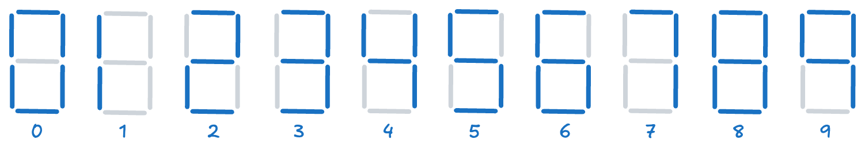
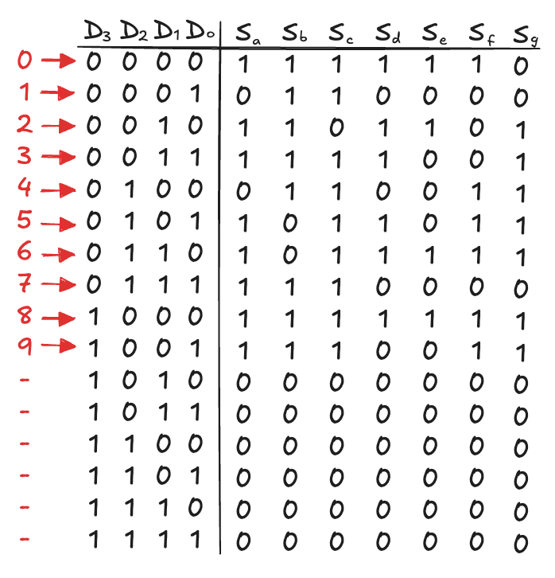
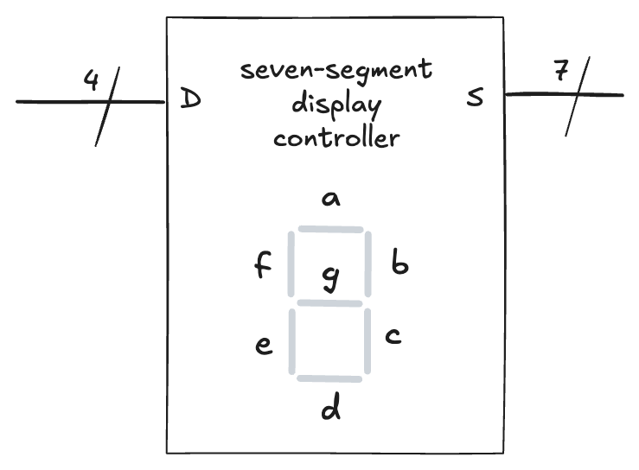
Seven-segment Display Controller (1)
A device that takes a 4-bit data input D_{3:0} and produces seven outputs S_{a} - S_{g} to control a display from 0 to 9

Slide 5
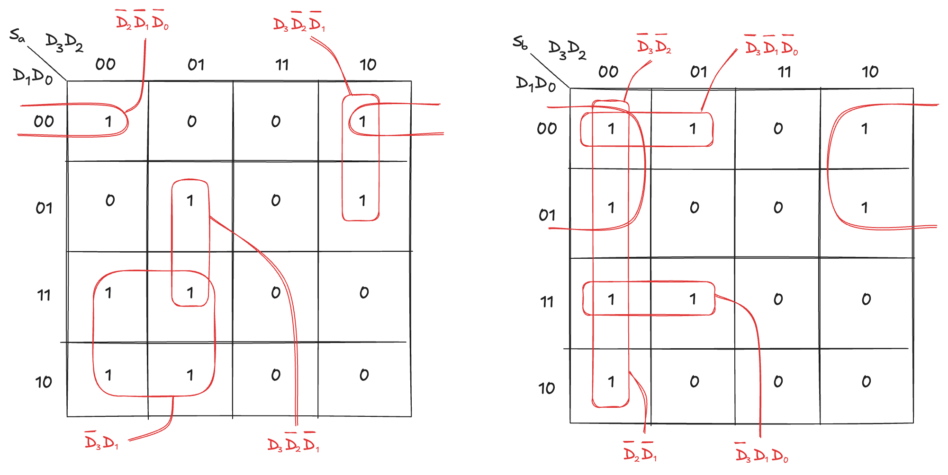
Seven-segment Display Controller (2)
Each of the seven outputs is an independent function of four variables
We can draw K-maps for each outputs

Slide 6
Don’t Cares (1)
Recall that “don’t care” entries for truth table inputs
can reduce the number of rows in the table when some variables do not affect the output
they are indicated by the symbol X, which means that the entry can be either 0 or 1
Don’t cares also appear in truth table outputs where:
the output value is unimportant
or the corresponding input combination can never happen
such outputs can be treated as either 0’s or 1’s at the designer’s discretion
In a K-map, X’s allow for even more logic minimization
they can be circled if they help cover the 1 with fewer or larger circles
but they do not have to be circled if they are not helpful

Slide 7
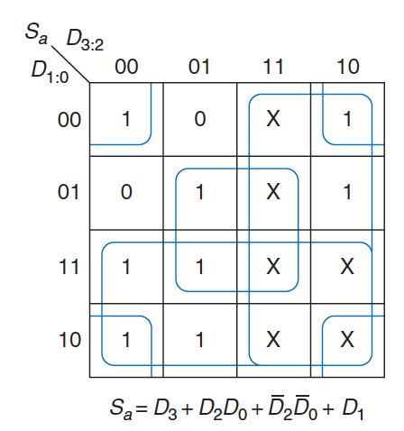
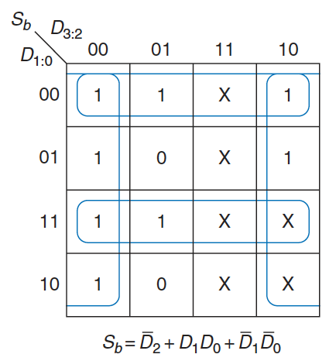
Don’t Cares (2)
We can review the seven-segment display decoder if we don’t care about the output values for illegal input values of 10 to 15
Because don’t cares can be 0 or 1, we circle a don’t care if it allows us to cover the 1 with fewer or bigger circles
Use of don’t cares simplifies the logic substantially

Slide 8
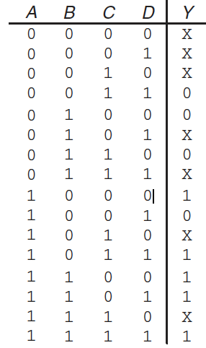
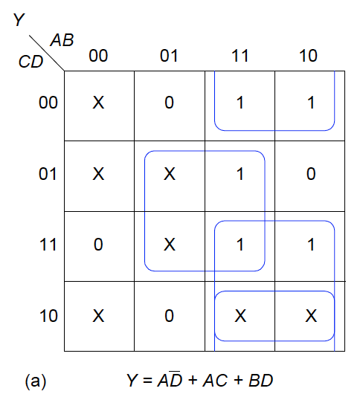
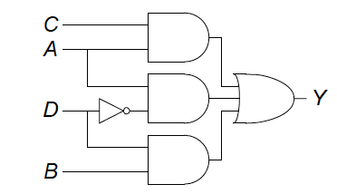
Exercises (1)
Ex5.4: Find a minimal Boolean equation for the following true table and sketch the circuit
Solution:

Slide 9
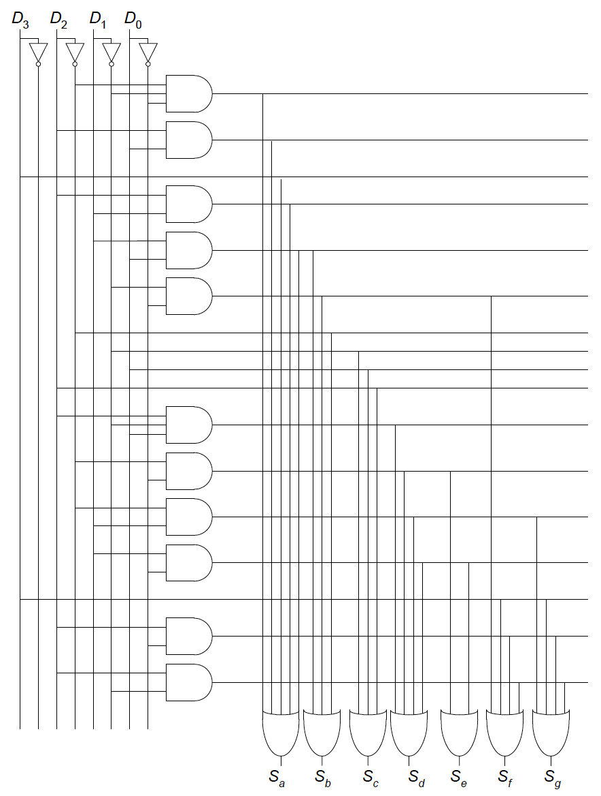
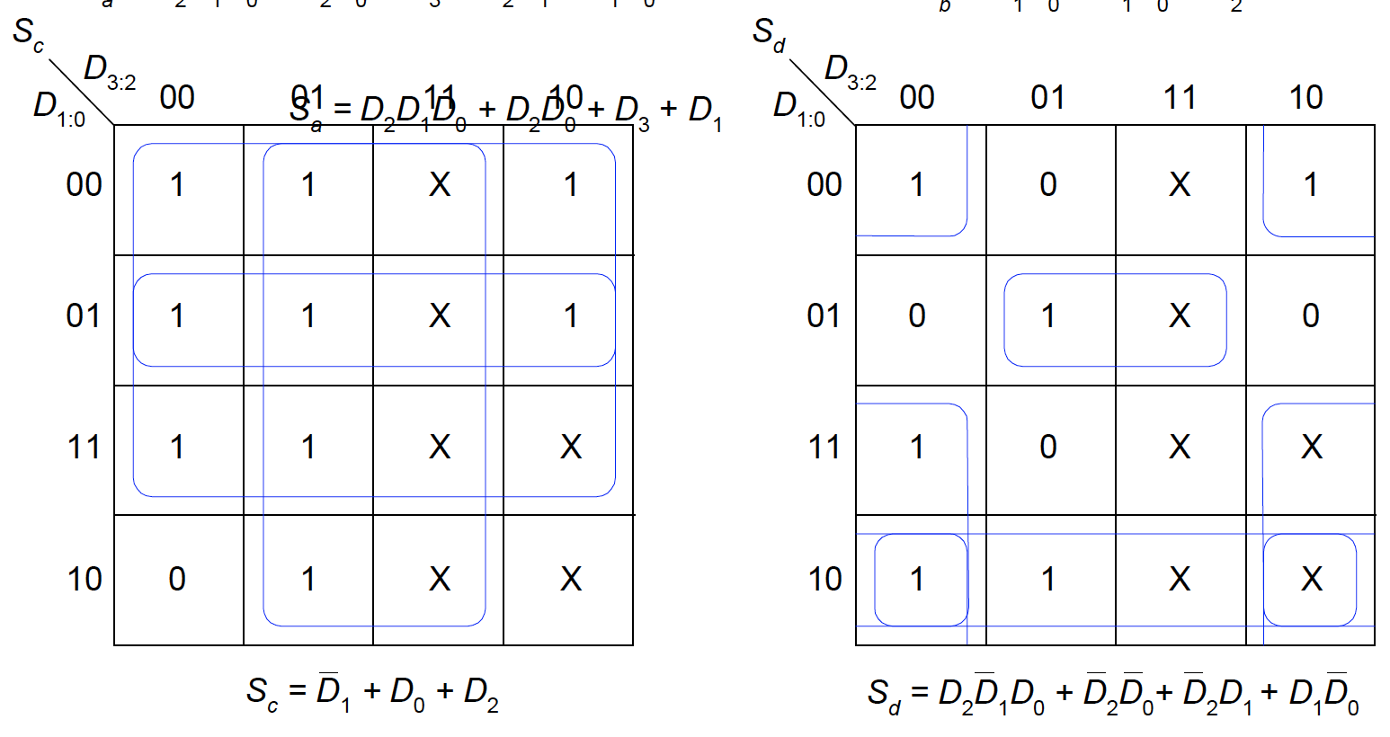
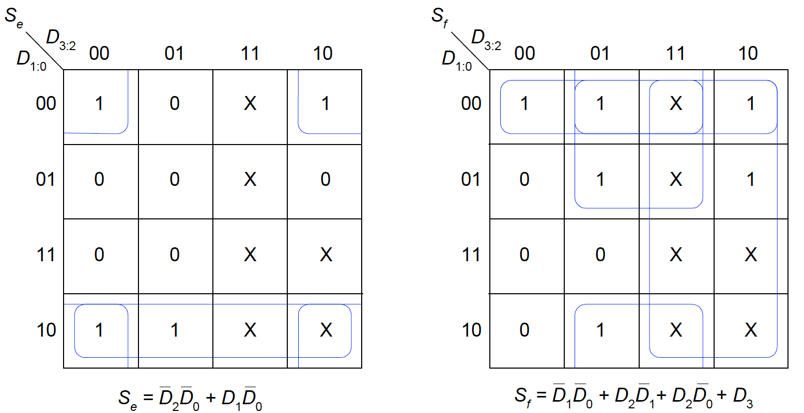
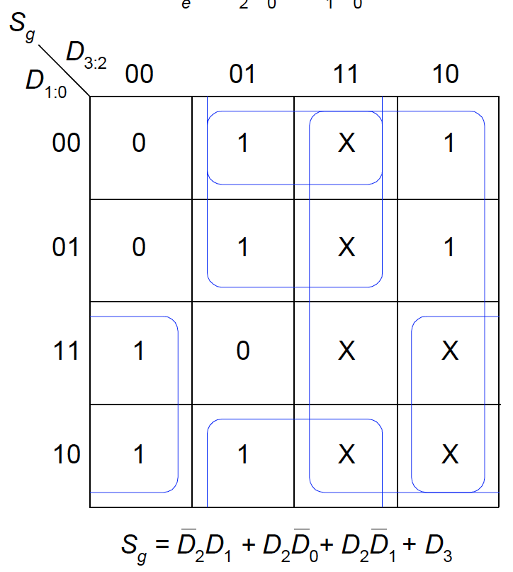
Exercises (2)
Ex5.6: Complete the design of the seven-segment decoder segments S_{c} through S_{g} and sketch a reasonably simple gate-level implementation of part
Solution:

